Slide 1
$Million Minimum Wage Increase Challenge
How One Manufacturer is Cutting Costs
to Stay in NY
Presented by:
Ron Loveland
President
Summit Safety & Efficiency Solutions
www.SummitSafetyPro.com

Slide 2
Summit Intro
Industrial Engineering Consultants helping manufacturers/industrial customers thrive in Metro NY by improving:
Safety
Quality
Efficiency

Slide 3
Manufacturer’s Challenge Case Study
Minimum Wage is Rising from $9 to $15 in NYC by 2018
550 employees x $1.75-$2 increase x 2080 hours/year =
>$2m labor cost increase/year!

Slide 4
Company’s Other Challenges
Market demands: increased sales and shorter lead times
Increased sales growth testing capacity
Large number of small orders require efficient setups
High labor turnover
Productivity issues – weak KPIs to assess
Limited structured problem solving

Slide 5
Company’s Situation
Low margin, highly competitive market
Labor intensive operations
Space constraints
Seasonal business, 600+ high, 500’s low
83% orders 500 or less
68% orders under 300 pieces

Slide 6
Opportunities
$1M Annual Expedite (Air Ship) Charges
$4M in Scrap
~35% Productivity
Too much WIP
Too many people

Slide 7
Approach & Methodology
Value Stream Mapping
Order Entry process
Manufacturing and detailed machine process steps
Process Observations
Various production departments
Order Management
Materials Management & Inventory Analysis
Cartons usage & procurement strategies – space
“SLOBS” – SLow moving and OBSolete material
Manufactured Product – usage & space

Slide 8
Overall Findings
No KPIs to drive corrective action
Inaccurate capacity planning
Inventory management/accuracy/warehouse management problems
Quality problems – screens – pinholes & registration
Too much/too little inventory on production floor
Only 35% production available time
Production intermittent-
Waiting QA, materials, setups, screen problems, …

Slide 9
Changes to Meet $Million Challenge
Document Best Practices to support training, continuous improvement, and workforce replacement
Develop training material for staff, both floor and office
Product Rationalization - Products with low and negative margins analyzed and phased out

Slide 10
Changes to Meet $Million Challenge Scrap
Color Coded Barrels placed at each print station increased visibility and accountability of scrap
Daily reporting by machine increased visibility & accountability (Hawthorne Effect)

Slide 11
Warehouse
Complete warehouse reorganization including location and count accuracy in a timely manner
Reduce transaction load on warehouse where possible
Warehouse issues should be full cartons– only count exact quantities when returning to warehouse
The staging area should be analyzed and organized to reduce extra handling and maximize use of space
Consolidate picks for like materials rather than per order

Slide 12
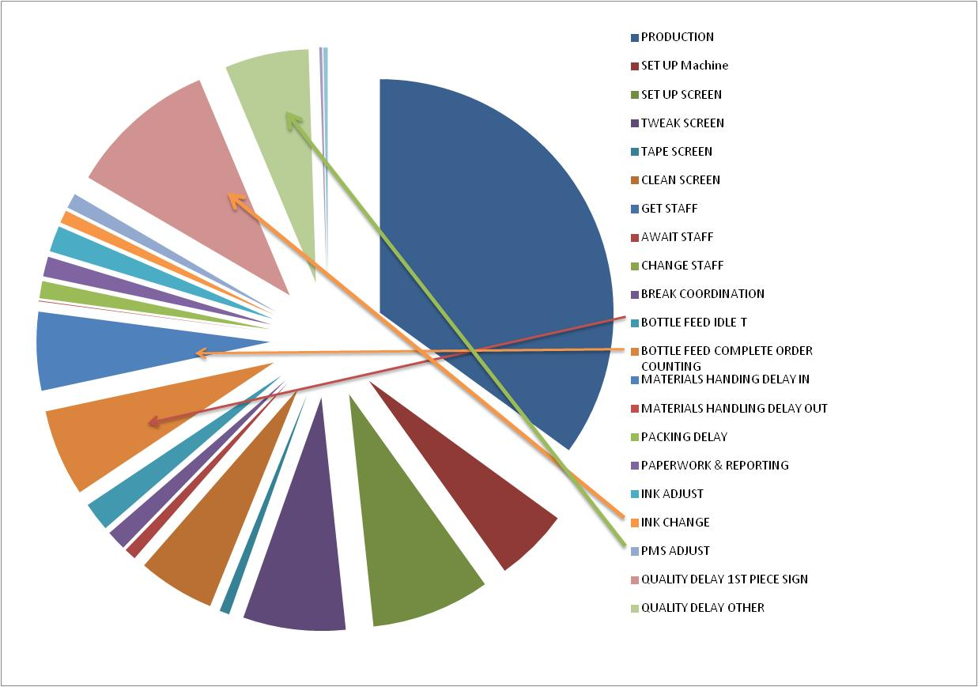
Where’s the Waste?

Slide 13
Opportunities to Meet $Million Challenge
The sum of the NVA activities identified totalled 53% available time
Reducing NVA activities across the production floor by only 10% to 15% could improve annual yield between
$760k to $1.1mm
+ $1m Scrap Savings
+$1m Expedite Shipping Savings

Slide 14
Savings Measures
Technical issues
Set up done while other machine operating (cell)
Screen alignment tools, improved screens
Non-technical Issues
Dedicated Quality person to speed sign off
Eliminate Counting by production personnel
Reduced Material handling delays/Warehouse improvements
Color coded barrels at each machine for scrap-Visual Factory
Product Rationalization

Slide 15
1st Year Savings Results
Eliminated:
$1m in Expedite charges
$2m in Scrap
125 fewer people=$2.86m

Slide 16
Other Savings Strategies
Industrial Development Agency Tax Abatement
Industrial Commercial Abatement Program
R&D Tax Credit
Solar Energy
Workers Compensation Insurance Reduction
NYC/NYS/Federal Grant & Tax Saving Programs

Slide 17
Summary
Minimum wage increase presents major challenge for most NY manufacturers
Improvements in Productivity, Quality and Inventory Management can help meet that challenge
The key is improving your processes and involving employees at all levels to sustain improvements
Constantly improve your processes by identifying and eliminating wasteful activity in the processes

Slide 18
Improve Business Performance Strategically
Questions?
Thank You
Ron Loveland
President
Summit Business Solutions
www.SummitSafetyPro.com
631-642-7239
ron.loveland@lovelandsolutions.com

